Slide 1
Computer Networks
SP-08
Copyright Seema Ansari

Slide 2
Objectives for Network Design
To minimize DOWNTIME
Allows users to work with other users regardless of computers used
The network should expand as they find other users for it.
To keep outsiders from unauthorized access
The ability to manage their networked devices from one place
SP-08
Copyright Seema Ansari

Slide 3
What is a network ?
A collection of computers and devices connected by communication channels that allows more users to share resources like data, information, hardware, and software.
A group of interconnected systems sharing services and interacting by means of a shared communications link.
SP-08
Copyright Seema Ansari

Slide 4
What is a Network ?
All Network must have…..
  Something to share (data)
  A physical pathway (Transmission Medium)
  Protocols
SP-08
Copyright Seema Ansari

Slide 5
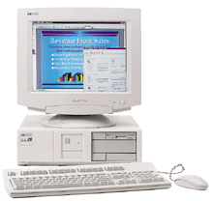
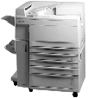
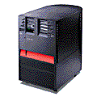



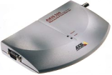
Typical Network
IBM Regatta
Multiplexor
Parallel
Serial
Windows 98
Country-wide Branches
18 units
Printers
At 15 branches
Multiplexor
Windows 2000 with
Designer Software
Protocol : TCP/IP
Serial
NT Server
Axis 560
Windows 2000 with
Lapres Run-time
7 units Printers
SP-08
Copyright Seema Ansari

Slide 6
Network Criteria
Performance
Reliability
Security
SP-08
Copyright Seema Ansari

Slide 7
Performance
# of users
Medium
Hardware
Software
SP-08
Copyright Seema Ansari

Slide 8



Why ?
To Share Peripherals
Printers
Scanners
Hard Disk
CD Rom
Plotters
Tape Backup
Reduce
Cost
SP-08
Copyright Seema Ansari

Slide 9
Why ?
Enabling Common Administration & Security
Network Applications
  Email
  Database Service
  Groupware
SP-08
Copyright Seema Ansari

Slide 10
Types of networks
Local Area Network (LAN)
Metropolitan Area Network (MAN)
Wide Area Network (WAN)
SP-08
Copyright Seema Ansari

Slide 11
Local Area Network - LAN
A network that connects computers in a limited area such as a school, company, or building.
Consists of a network operating system, networked computers, network interface card, and a communication channel.
LANs are privately controlled w.r.t data processing equipment.
SP-08
Copyright Seema Ansari

Slide 12
Local Area Network - LAN
The two popular types of LANs are :
Peer-to-Peer.
Client / Server.
SP-08
Copyright Seema Ansari

Slide 13
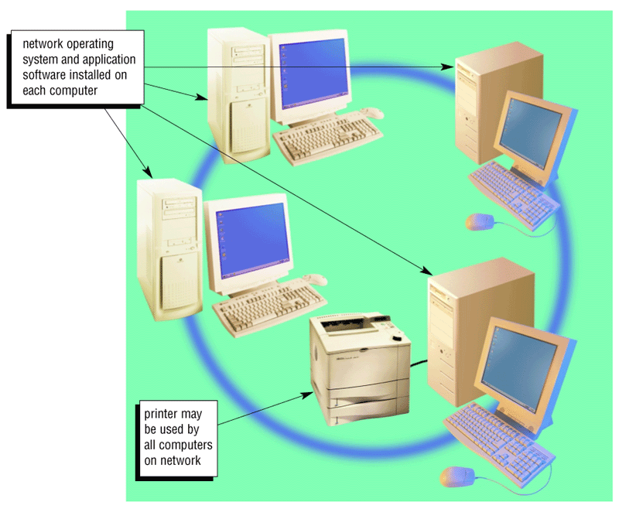
Peer-to-peer LAN
SP-08
Copyright Seema Ansari

Slide 14
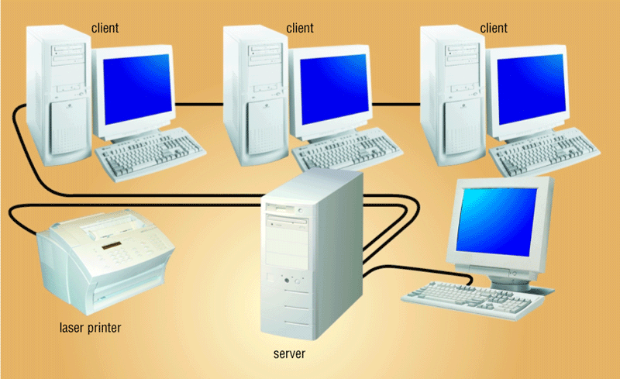
Client / Server
SP-08
Copyright Seema Ansari

Slide 15
METROPOLITAN AREA NETWORK (MAN)
MANs connect locations that are geographically located from 5 to 50 kilometres.
They include the transmission of data, voice and television signals through the use of coaxial cables or optical fiber cables as their primary medium of transmission.
SP-08
Copyright Seema Ansari

Slide 16
Wide Area Network - WAN
Covers a large area using a communication channel.
Connects two or more LANs.
Internet is the largest WAN.
WANs use a broad range of communication channel for interconnection that includes switched and leased lines, private microwave circuits, optical fibre, coaxial cable and satellite circuits. However, most WANs implement LAN inter-connectivity via Public Switched Telephone Networks (PSTNs)
SP-08
Copyright Seema Ansari

Slide 17
NETWORK TOPOLOGY
The configurations used to describe networks are sometimes called Network architecture or network topology. The most common network topologies are:
Ring
Bus
Star
Mesh
hybrid
SP-08
Copyright Seema Ansari

Slide 18
Ring network
Data travels around the ring in one direction.
The message knows the destination because each workstation in the ring network has a unique address.
Advantages:
High reliability
Easy expandability
Normally lower cost than star and hybrid networks.
SP-08
Copyright Seema Ansari

Slide 19
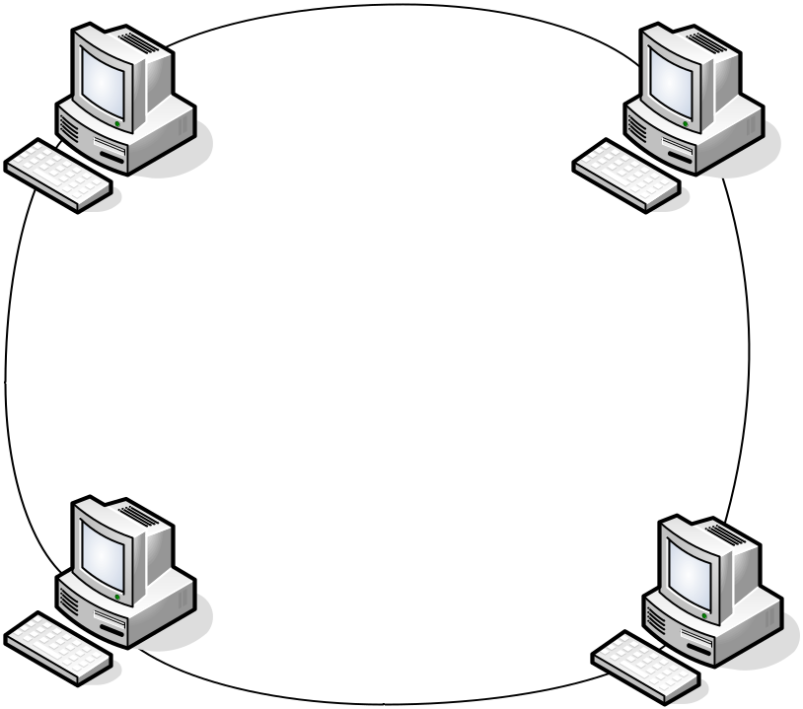
Ring network topology
SP-08
Copyright Seema Ansari

Slide 20
Bus Network
Connects all networked devices to a single cable (called the Bus) running the length of the network.
Advantages:
Good reliability, unless the bus itself malfunctions.
Very easy to expand
SP-08
Copyright Seema Ansari

Slide 21
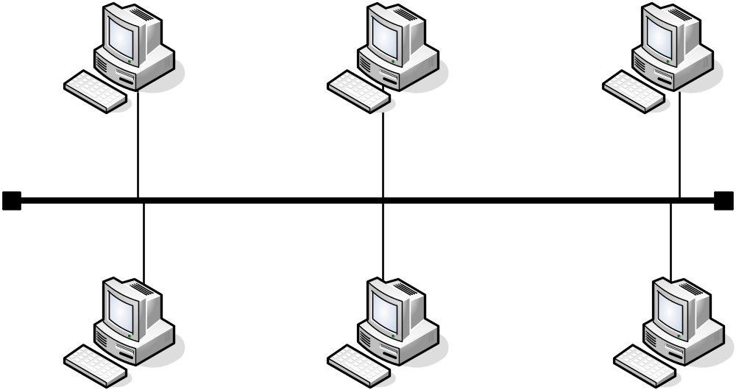
Bus Network Topology
SP-08
Copyright Seema Ansari

Slide 22
Star Network
All devices on the network are connected to a central device that controls the entire network.
The central location receives message from a sending node and forwards them to the destination node.
Advantages:
provides the shortest path between nodes in the network
Provides the user with a high degree of central network control
Relatively easy to expand the network.
Disadvantage:
If the central station (hub) malfunctions, the entire network would fail.
SP-08
Copyright Seema Ansari

Slide 23
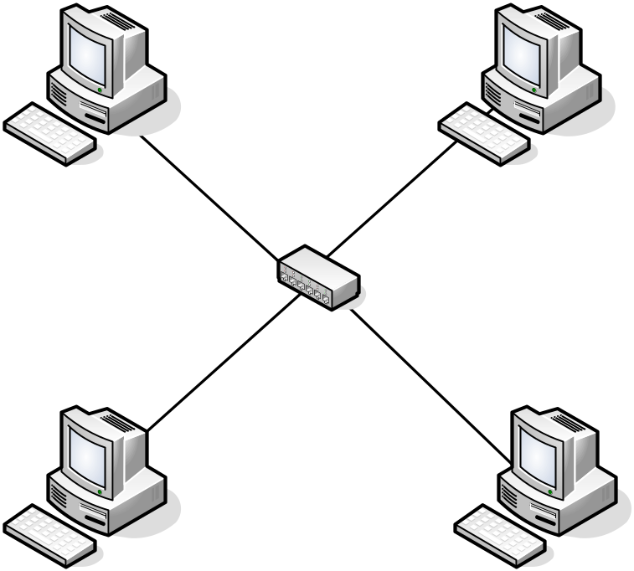
Star Network Topology
SP-08
Copyright Seema Ansari

Slide 24
Mesh Network
Each node has a direct point to point connection to every other node in the network.
Provides best performance as every node on the network has a direct route to every other node.
Disadvantage: Cost of setting up a mesh network can be very expensive.
N=nodes; no. of links= n(n-1)/2
SP-08
Copyright Seema Ansari

Slide 25
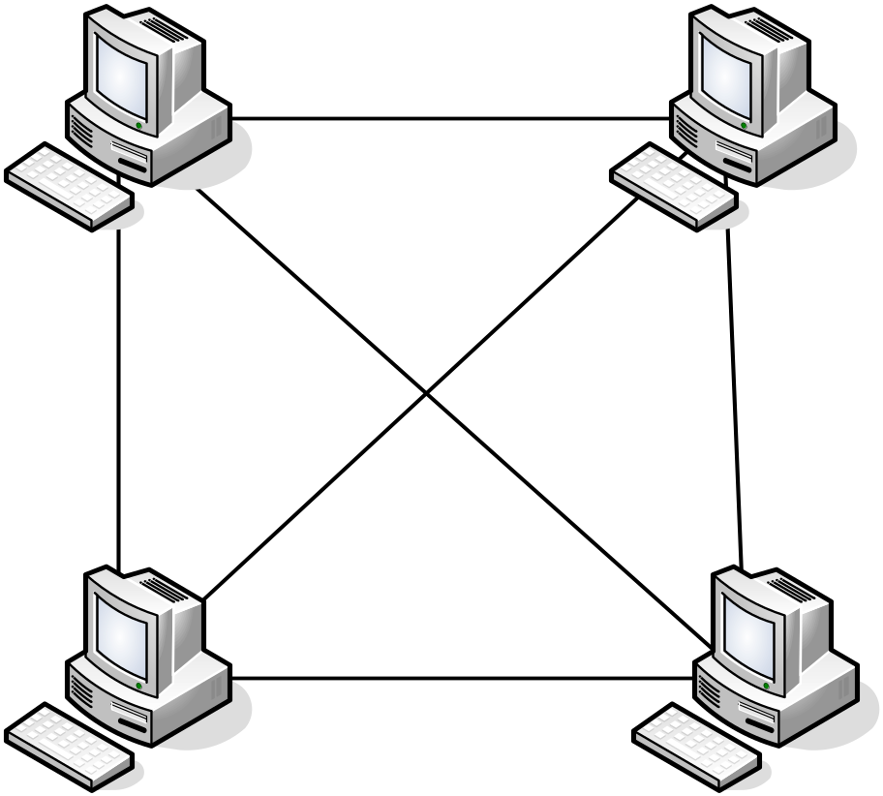
Mesh Network Topology
SP-08
Copyright Seema Ansari

Slide 26
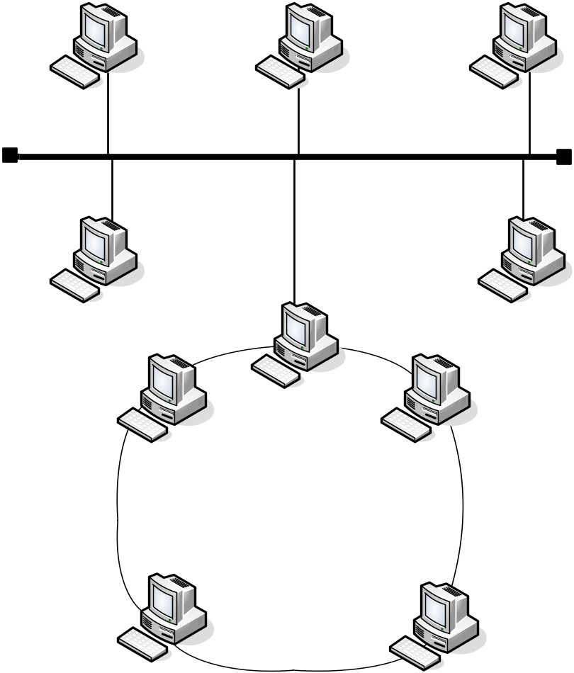
Hybrid Network
Combination of more than one of the network configurations. Example: a bus network may have a ring network as one of its links.
SP-08
Copyright Seema Ansari

Slide 27
LAN Architectures
Together with the appropriate transmission media, the LAN topologies provide the basic physical elements for the design of Local area networks.
Three of the most commonly used LAN architectures that have evolved are:
Ethernet
Token ring
Token Bus
SP-08
Copyright Seema Ansari

